Slide 1
Cristalografia
Organização espacial de átomos e moléculas para compor materiais sólidos.
Professor: Paulo Moscon

Slide 2
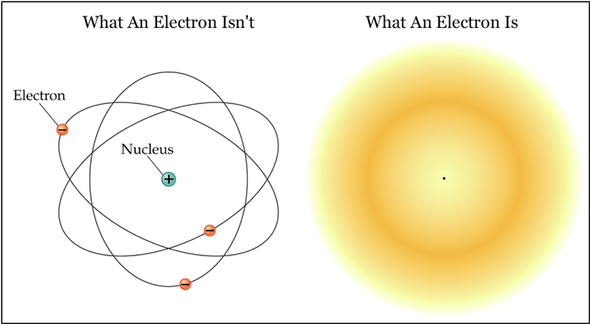
Nuvem eletrônica de um único elétron

Slide 3
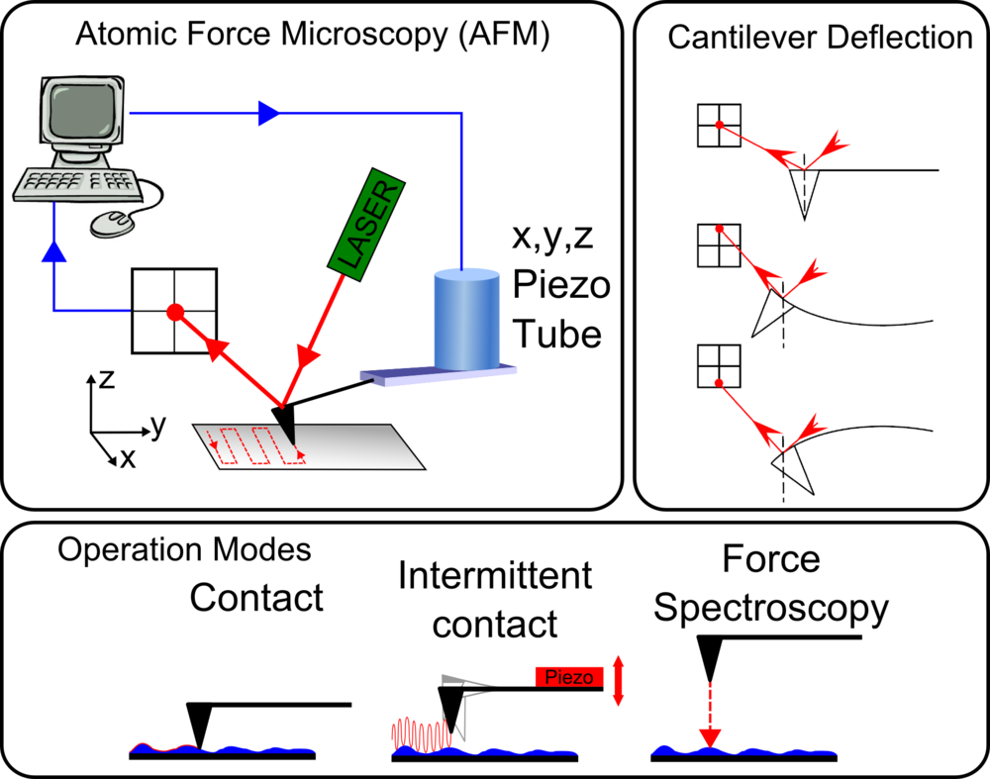

Slide 4
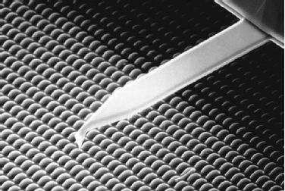
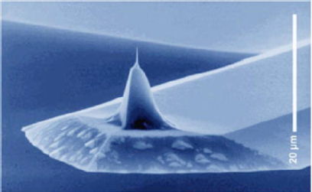

Slide 5
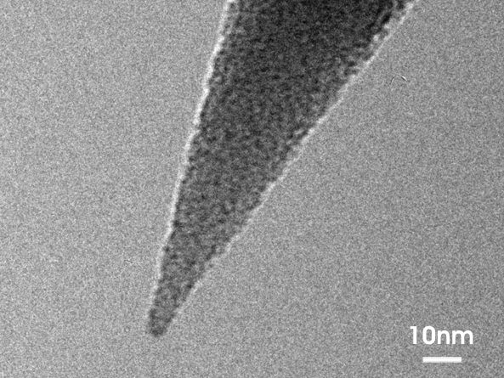

Slide 6
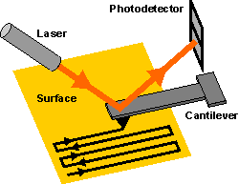

Slide 7
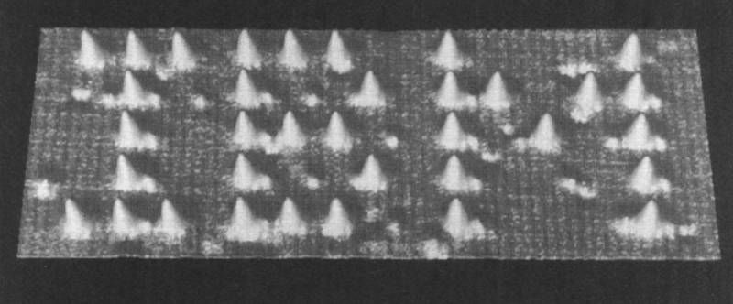
Imagem real
STM image: Scanning tunneling microscope

Slide 8
Imagem real

Slide 9
Imagem real
Imagem obtida por Microscopia eletrônica de transmissão (MET)

Slide 10
Materials and Packing
Crystalline materials...
• atoms pack in periodic, 3D arrays
• typical of:
-metals
-many ceramics
-some polymers
crystalline SiO2
Adapted from Fig. 3.23(a),
Callister & Rethwisch 8e.
Si
Oxygen
Noncrystalline materials...
• atoms have no periodic packing
• occurs for:
-complex structures
-rapid cooling
"Amorphous" = Noncrystalline
noncrystalline SiO2
Adapted from Fig. 3.23(b),
Callister & Rethwisch 8e.

Slide 11
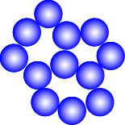
Energy and Packing
• Non dense, random packing
Energy
typical neighbor
bond length
typical neighbor
r
bond energy
• Dense, ordered packing
Energy
typical neighbor
bond length
typical neighbor
r
bond energy
Dense, ordered packed structures tend to have
lower energies.

Slide 12
Ferramental matemático para estudar materiais sólidos
Um cristal é um arranjo periódico
As propriedades locais se repetem de com mesma periodicidade
Uma equação para localizar pontos equivalentes no espaço
Nota-se que apenas algumas geometrias de células unitárias são capazes de preencher o espaço sem deixar buracos

Slide 13
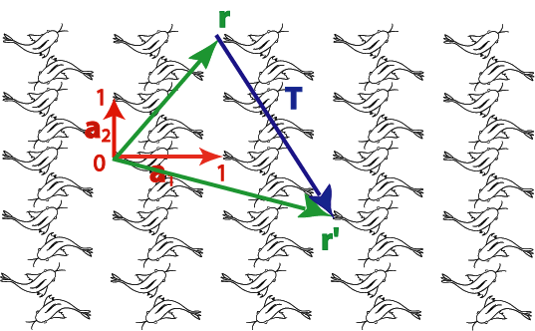
Equação de base

Slide 14
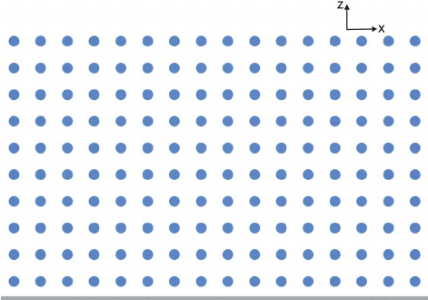

Slide 17
Geometrias que preenchem o espaço
1-Fold Rotation Axis - An object that requires rotation of a full 360o in order to restore it to its original appearance has no rotational symmetry. Since it repeats itself 1 time every 360o it is said to have a 1-fold axis of rotational symmetry.
2-fold Rotation Axis - If an object appears identical after a rotation of 180o, that is twice in a 360o rotation, then it is said to have a 2-fold rotation axis (360/180 = 2). Note that in these examples the axes we are referring to are imaginary lines that extend toward you perpendicular to the page or blackboard. A filled oval shape represents the point where the 2-fold rotation axis intersects the page.
3-Fold Rotation Axis- Objects that repeat themselves upon rotation of 120o are said to have a 3-fold axis of rotational symmetry (360/120 =3), and they will repeat 3 times in a 360o rotation. A filled triangle is used to symbolize the location of 3-fold rotation axis.
4-Fold Rotation Axis - If an object repeats itself after 90o of rotation, it will repeat 4 times in a 360o rotation, as illustrated previously. A filled square is used to symbolize the location of 4-fold axis of rotational symmetry.
6-Fold Rotation Axis - If rotation of 60o about an axis causes the object to repeat itself, then it has 6-fold axis of rotational symmetry (360/60=6). A filled hexagon is used as the symbol for a 6-fold rotation axis.

Slide 18
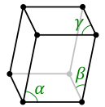
Lattice types
B3. Bravais lattices in 3D : 14
system | Number of lattices | Cell axes and angles
Triclinic | 1 | |a₁|≠|a₂|≠|a₃| , α≠β≠γ
Monoclinic | 2 | |a₁|≠|a₂|≠|a₃| , α=γ=90°≠β
Orthorhombic | 4 | |a₁|≠|a₂|≠|a₃| , α=β=γ=90°
Tetragonal | 2 | |a₁|=|a₂|≠|a₃| , α=β=γ=90°
Cubic | 3 | |a₁|=|a₂|=|a₃| , α=β=γ=90°
Trigonal | 1 | |a₁|=|a₂|=|a₃| , α=β=γ<120°≠90°
Hexagonal | 1 | |a₁|=|a₂|≠|a₃| , α=β=90° γ=120°

Slide 19
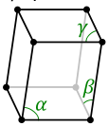
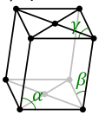
Lattice types
B3. Bravais lattices in 3D : 14
system | Number of lattices | Cell axes and angles
Triclinic | 1 | |a₁|≠|a₂|≠|a₃| , α≠β≠γ
Monoclinic | 2 | |a₁|≠|a₂|≠|a₃| , α=γ=90°≠β
Orthorhombic | 4 | |a₁|≠|a₂|≠|a₃| , α=β=γ=90°
Tetragonal | 2 | |a₁|=|a₂|≠|a₃| , α=β=γ=90°
Cubic | 3 | |a₁|=|a₂|=|a₃| , α=β=γ=90°
Trigonal | 1 | |a₁|=|a₂|=|a₃| , α=β=γ<120°≠90°
Hexagonal | 1 | |a₁|=|a₂|≠|a₃| , α=β=90° γ=120°
Base centered
monoclinic

Slide 20
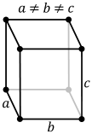
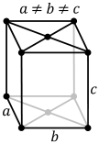
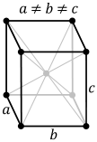
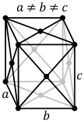
Lattice types
B3. Bravais lattices in 3D : 14
system | Number of lattices | Cell axes and angles
Triclinic | 1 | |a₁|≠|a₂|≠|a₃| , α≠β≠γ
Monoclinic | 2 | |a₁|≠|a₂|≠|a₃| , α=γ=90°≠β
Orthorhombic | 4 | |a₁|≠|a₂|≠|a₃| , α=β=γ=90°
Tetragonal | 2 | |a₁|=|a₂|≠|a₃| , α=β=γ=90°
Cubic | 3 | |a₁|=|a₂|=|a₃| , α=β=γ=90°
Trigonal | 1 | |a₁|=|a₂|=|a₃| , α=β=γ<120°≠90°
Hexagonal | 1 | |a₁|=|a₂|≠|a₃| , α=β=90° γ=120°
Base centered
orthorhombic
Body centered
orthorhombic
Face centered
orthorhombic

Slide 21
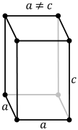
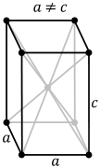
Lattice types
B3. Bravais lattices in 3D : 14
system | Number of lattices | Cell axes and angles
Triclinic | 1 | |a₁|≠|a₂|≠|a₃| , α≠β≠γ
Monoclinic | 2 | |a₁|≠|a₂|≠|a₃| , α=γ=90°≠β
Orthorhombic | 4 | |a₁|≠|a₂|≠|a₃| , α=β=γ=90°
Tetragonal | 2 | |a₁|=|a₂|≠|a₃| , α=β=γ=90°
Cubic | 3 | |a₁|=|a₂|=|a₃| , α=β=γ=90°
Trigonal | 1 | |a₁|=|a₂|=|a₃| , α=β=γ<120°≠90°
Hexagonal | 1 | |a₁|=|a₂|≠|a₃| , α=β=90° γ=120°
Body centered
tetragonal

Slide 22
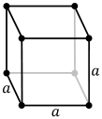
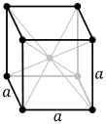
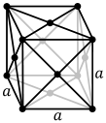
Lattice types
B3. Bravais lattices in 3D : 14
system | Number of lattices | Cell axes and angles
Triclinic | 1 | |a₁|≠|a₂|≠|a₃| , α≠β≠γ
Monoclinic | 2 | |a₁|≠|a₂|≠|a₃| , α=γ=90°≠β
Orthorhombic | 4 | |a₁|≠|a₂|≠|a₃| , α=β=γ=90°
Tetragonal | 2 | |a₁|=|a₂|≠|a₃| , α=β=γ=90°
Cubic | 3 | |a₁|=|a₂|=|a₃| , α=β=γ=90°
Trigonal | 1 | |a₁|=|a₂|=|a₃| , α=β=γ<120°≠90°
Hexagonal | 1 | |a₁|=|a₂|≠|a₃| , α=β=90° γ=120°
Simple cubic sc
Body centered cubic bcc
Face centered cubic fcc

Slide 23
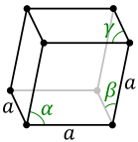
Lattice types
B3. Bravais lattices in 3D : 14
system | Number of lattices | Cell axes and angles
Triclinic | 1 | |a₁|≠|a₂|≠|a₃| , α≠β≠γ
Monoclinic | 2 | |a₁|≠|a₂|≠|a₃| , α=γ=90°≠β
Orthorhombic | 4 | |a₁|≠|a₂|≠|a₃| , α=β=γ=90°
Tetragonal | 2 | |a₁|=|a₂|≠|a₃| , α=β=γ=90°
Cubic | 3 | |a₁|=|a₂|=|a₃| , α=β=γ=90°
Trigonal | 1 | |a₁|=|a₂|=|a₃| , α=β=γ<120°≠90°
Hexagonal | 1 | |a₁|=|a₂|≠|a₃| , α=β=90° γ=120°

Slide 24
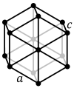
Lattice types
B3. Bravais lattices in 3D : 14
system | Number of lattices | Cell axes and angles
Triclinic | 1 | |a₁|≠|a₂|≠|a₃| , α≠β≠γ
Monoclinic | 2 | |a₁|≠|a₂|≠|a₃| , α=γ=90°≠β
Orthorhombic | 4 | |a₁|≠|a₂|≠|a₃| , α=β=γ=90°
Tetragonal | 2 | |a₁|=|a₂|≠|a₃| , α=β=γ=90°
Cubic | 3 | |a₁|=|a₂|=|a₃| , α=β=γ=90°
Trigonal | 1 | |a₁|=|a₂|=|a₃| , α=β=γ<120°≠90°
Hexagonal | 1 | |a₁|=|a₂|≠|a₃| , α=β=90° γ=120°

Slide 25
Apenas paralelepípedos conseguem preencher o espaço
7 tipos simetrias de paralelepípedos foram classificadas com base nos três ângulos diretores e nos três comprimentos das arestas
Vértices, centros e centros das faces, são pontos de simetrias que quando considerados, aumentam de 7 para 28 os tipos de paralelepípedos
Destas 28 apenas 14 são verdadeiramente diferentes.

Slide 26
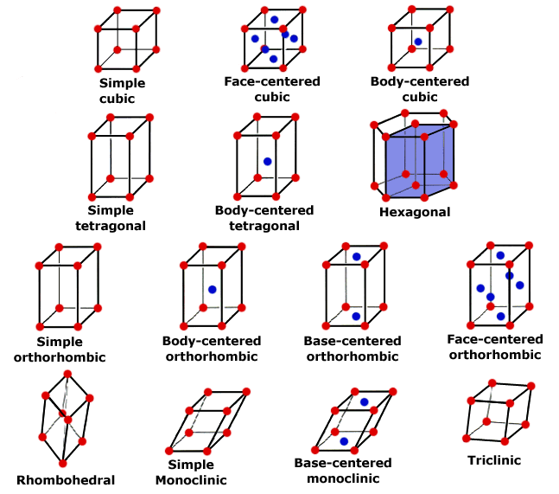
Apenas paralelepípedos ?
e a estrutura hexagonal?
•
•

Slide 27
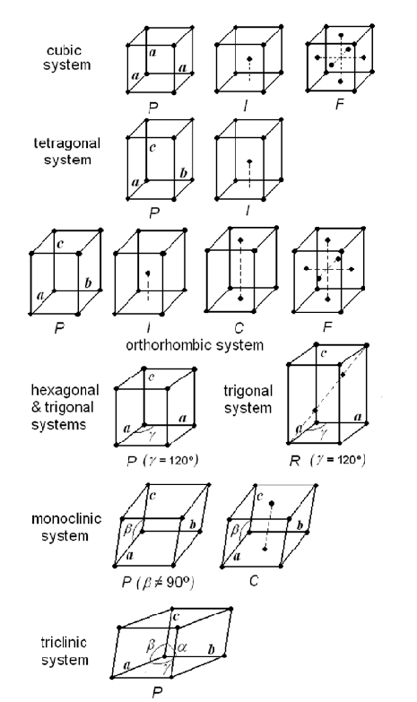
Existem apenas 14 arranjos cristalinos possíveis

Slide 28
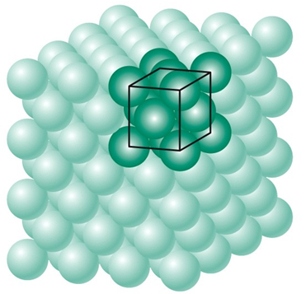
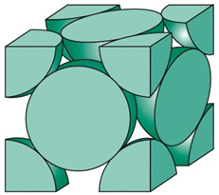
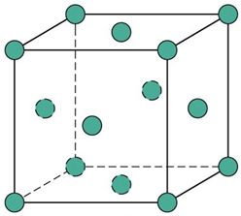
Modelo de esferas rígidas
Define-se uma célula que repetida no espaço, reproduz o sólido.

Slide 29
Metais
Ligações não direcionais
A energia do sistema é mínima quando a distância entre os vizinhos é minimizada
A nuvem eletrônica Blinda o núcleo; tal como uma gaiola de Faraday
Como consequência disso, os metais tem as estruturas mais simples, geometricamente

Slide 31
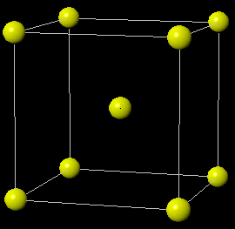
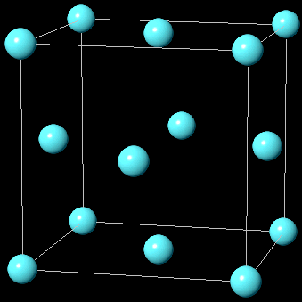
Exemplos
Cúbico de corpo centrado (CCC)
Body central cubic (BCC)
Cúbico de face centrada (CFC)
Face central cubic (FCC)
http://higheredbcs.wiley.com/legacy/college/callister/1118061608/vmse/xtalc.htm

Slide 33
Fator de empacotamento atômico (FEA)

